Slide 1
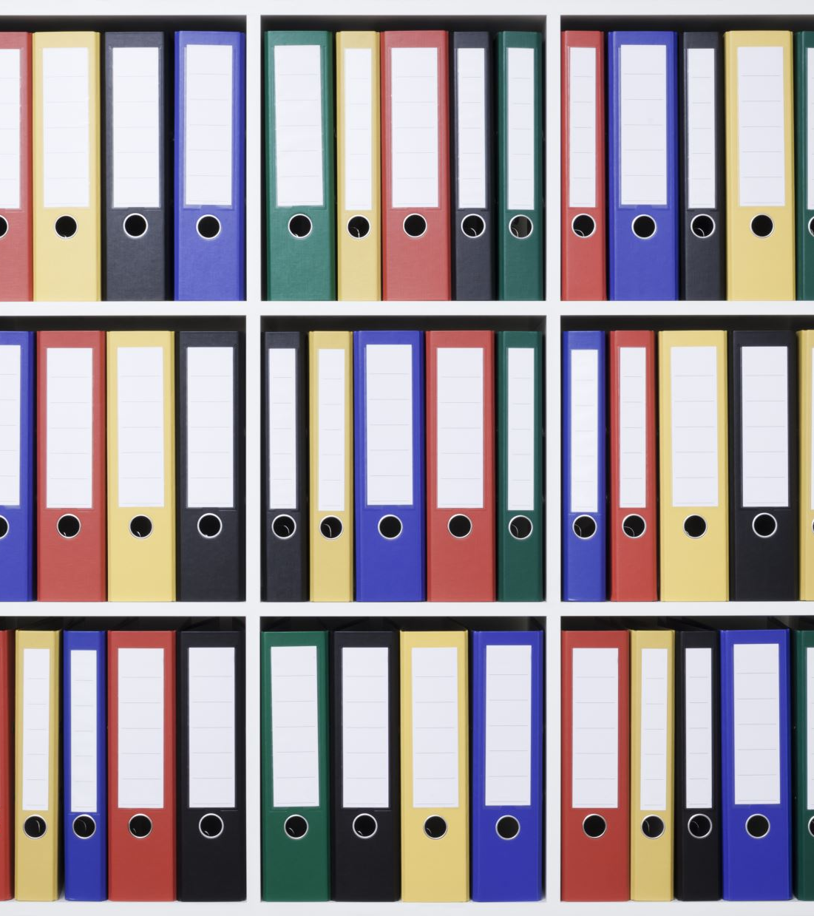
Group #2: Case Study report
By: Tyler Postma
Logan Lyons
Sai Parwatha
Zane Zahid

Slide 2
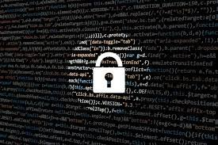
Risks Associated with Financial Statements Due to Failures in Password Policy

Slide 3
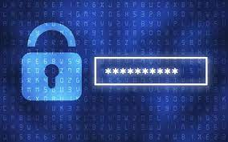
Breach of Confidentiality and Data Integrity
Risk Description:
The integrity and confidentiality of financial information are at risk due to weak password policies, which raise the possibility of a data breach.
Potential Impact of the Risk on Financial Statements:
Sensitive financial information may be revealed via a data breach, which could result in losses to one's reputation, legal repercussions, and financial hardship.
Potential Test to Determine Exposure:
Conduct penetration testing to see how susceptible systems are to possible breaches and to gauge how well data encryption and access controls are working.

Slide 4
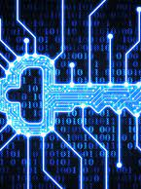
Unauthorized Financial System Access
Describe the Risk:
Unauthorized access to financial systems could result in the manipulation of financial data if password policies are lax.
How the Risk Could Affect Financial Accounts:
Unauthorized access can lead to financial manipulations such as fraudulent transactions, unapproved fund transfers, or other schemes that distort financial results.
Potential Examination to Assess Exposure:
Examine access records and login logs, searching for any unwanted access attempts or odd user login habits.

Slide 5

Mitigation Strategies
Mitigation Strategies:
Implement strong password policies.
Conduct regular security audits and penetration testing.
Educate employees on cybersecurity best practices.

Slide 6
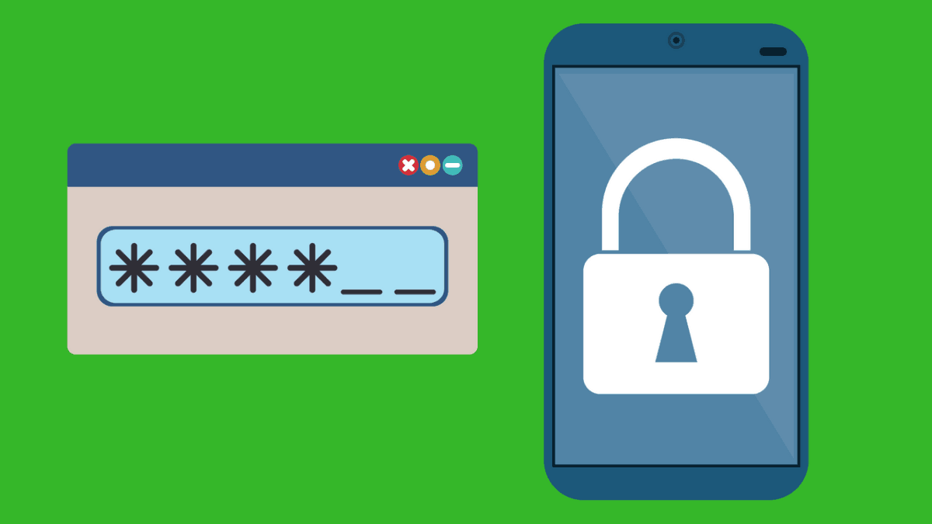
Password Policy Guidelines
Length of password:
Recommend minimum 14 characters for non - MFA and 8 for MFA accounts
Longer passwords are more secure against brute force attacks and guessing
Special Character Requirements:
At least 1 special character recommended for password composition.
Special characters increase complexity and unpredictability, enhancing password security.

Slide 7
Capitalization Recommendations:
Use at least 1 uppercase letter in passwords.
Avoid predictable capitalization patterns to improve password security.
Passwords on Deny Lists:
Maintain a deny list of common or compromised passwords to prevent their use.
Helps mitigate risks associated with easily guessed or previously compromised passwords.

Slide 8
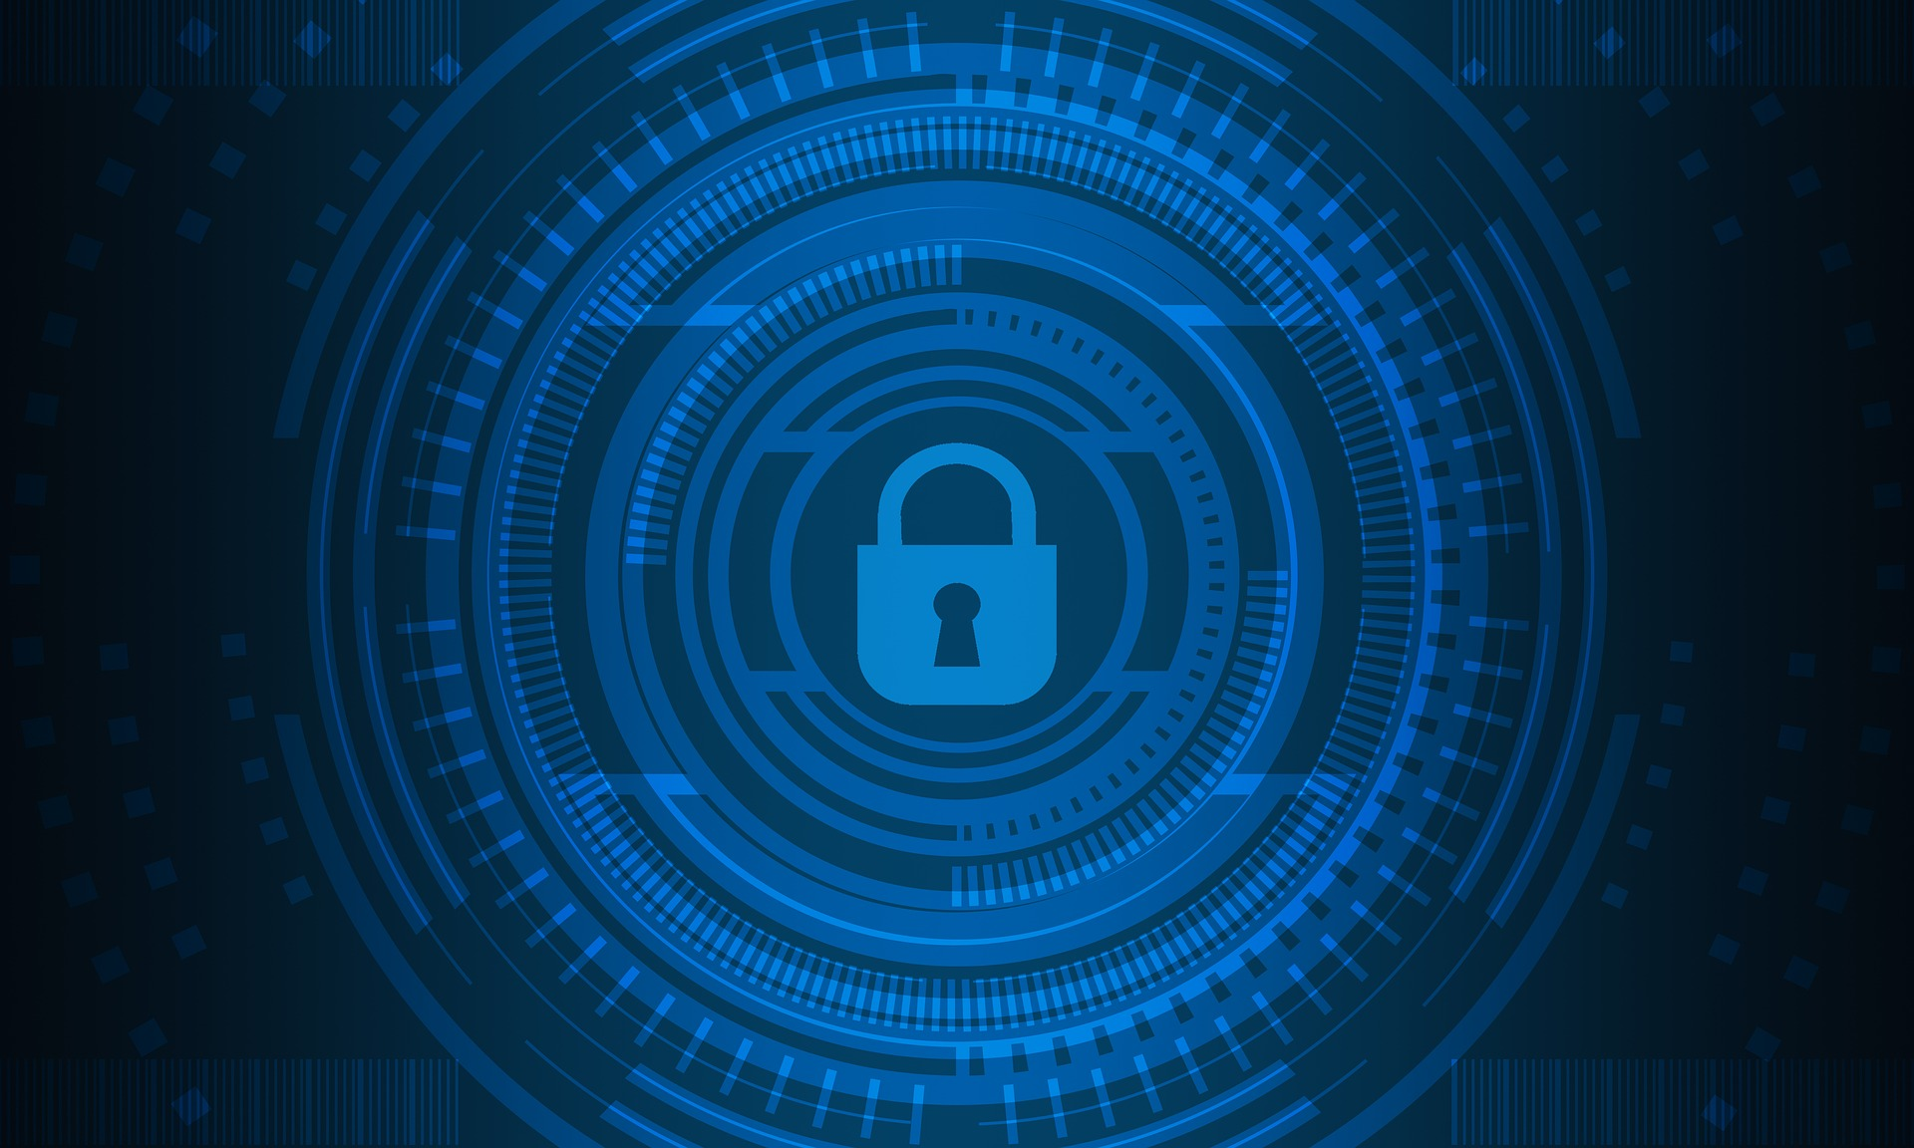
Dictionary Words vs. Passphrases:
Encourage the use of longer passphrases over single dictionary words.
Passphrases offer higher entropy and security while remaining memorable for users.
Multi-Factor Authentication (MFA):
Highly recommended for enhanced account security.
Combines multiple authentication factors to significantly increase the difficulty of unauthorized access.

Slide 9
Password sample results
Of the 30 sampled passwords only 12 (40%) of them met password complexity requirements.
6 (20%) of the passwords could be easily found through brute force or dictionary attacks
5 (~17%) of the passwords could be guessed with a combination of personal information and a dictionary attack.
7 (~23%) of the passwords met certain complexity requirements, but may have missed length or special characters

Slide 10
Automated password analysis
Python was utilized to look at a larger data set of passwords
Tests were written to validate the following information:
Passwords with less than 8 characters in length
Passwords that only contained letters
Passwords that only contained upper- or lower-case letters
Passwords that were used by other users
Passwords that had not been changed by the user
Passwords that had not been changed within the last 90 days
A test was also generated to compare the passwords against 2 million passwords discovered during breaches, as well as a list of "good" passwords.

Slide 11
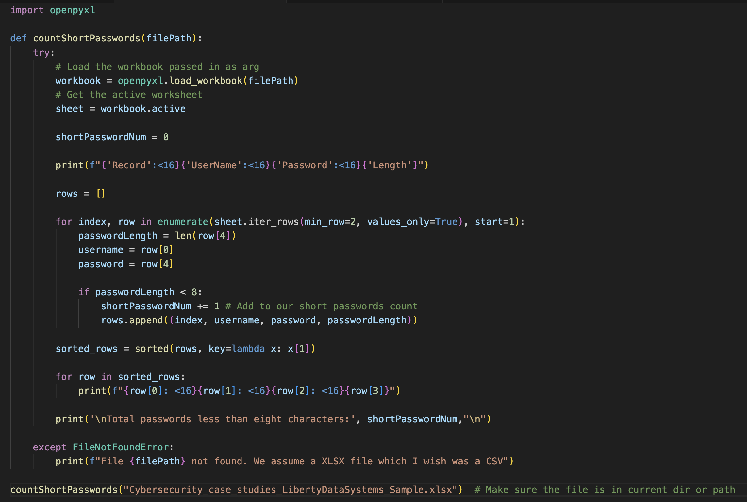
Automated analysis code demo.

Slide 12

Main concerns
Repetition of Passwords
Use of personal information in passwords
Weak passwords

Slide 13

Final thoughts
Biggest takeaway
Address the issue
Real-world scenario

